Slide 1
CSE332 INDUSTRY ETHICS AND LEGAL ISSUES

Slide 2
Patents

Slide 3
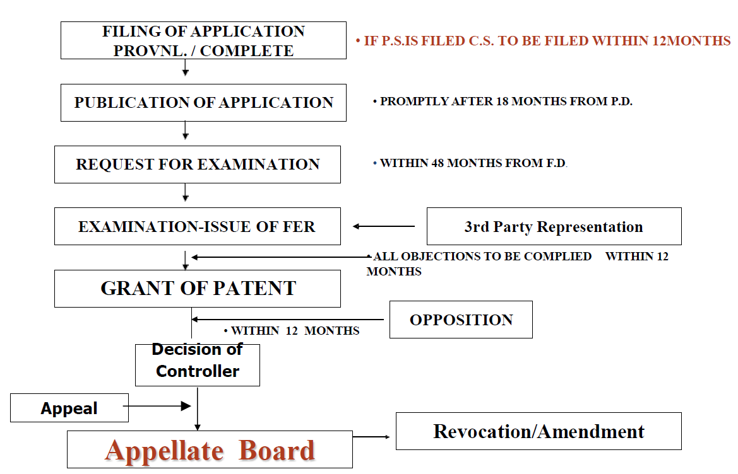
Stages from filing to grant of a patent

Slide 4
Publication and Examination
Rule24-B:Examinationofapplication
Examination request for divisional application:
1. 48 months from filing date or priority date, whichever or 6 months from further application filing.
2. Controller refers to Examiner within 1 month from publication or examination request receipt date whichever is earlier.
3. Examiner prepares report in 1-3 months.

Slide 5
Publication and Examination
Rule24-B:Examinationofapplication(contd.)
1. Controller disposes examiner's report within one month of receipt.
2. First Examination Report sent within 6 months of examination request or publication, whichever is later.
3. Third-party requesters receive intimation upon filing examination request.
4. Applicant complies with requirements within 12 months of objection.

Slide 6
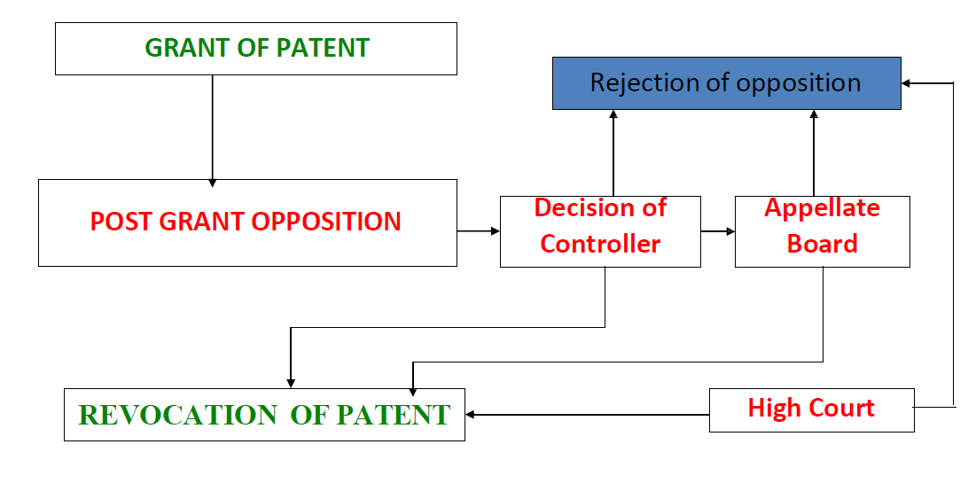
A PROCEDURE FROM FILING TO
GRANT OF PATENT (Cont.)

Slide 7
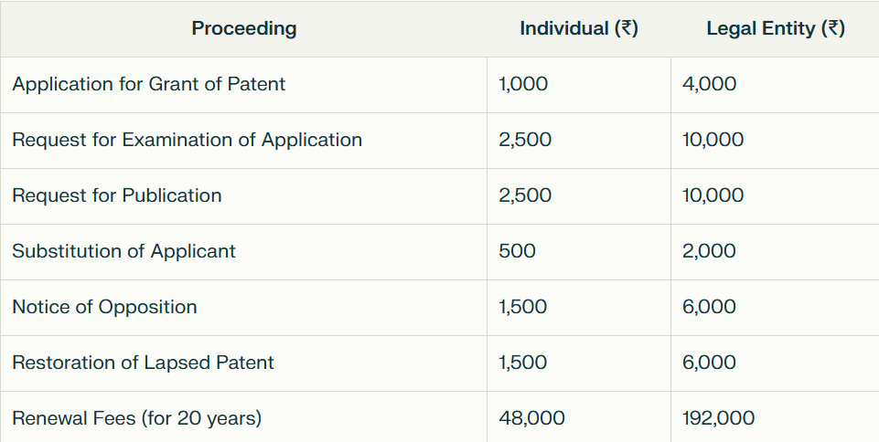
IMPORTANT FEES IN DIFFERENT PROCEEDINGS
Note: Professional Patent Drafting costs approximately ₹30,000

Slide 8
DUTIES OF PATENTEE
Maintenance of the patent
Pay renewal fees
Every year till the end of the term
Time limit:
before end of the preceeding year ( 6months extn. Available )
Working of the patents:
Inventions are to be worked in India on commercial scale
Failing which compulsory licencemay be issued

Slide 9
Patent Infringement
Demand the infringer stop & pay damages for past infringement.
2. Offer a “Royalty”
3. Ignore the infringement or postpone action.
4. File a patent infringement lawsuit in federal court

Slide 10
Litigation vs Licensing
If the objective is to stop a
competitor from offering a
product that infringes one’s patent.
If the objective is to obtain royalty
for the use of one’s invention.
Alternatives To Litigation
Litigations are costly, timely, & disruptive
Alternative dispute resolutions (ADR) include Mediation & Arbitration

Slide 11
Trade-Related Aspects of Intellectual
Property Rights(TRIPS) in the World
Trade Organization Compliance
TRIPS Agreement elevated IPR protection internationally binding.
India signed TRIPS Agreement in 1995 and implementing required changes.
India enacted TRIPS-compliant IP laws for trademarks, copyright, designs, GI, and integrated circuits.

